Slide 1
Hybrid optimisation for TSP
Junghyun Lee (20170500)
Dept. of Mathematical Sciences & School of Computing, KAIST

Slide 2
Preview
k-means clustering
Intracluster ACOs
Intercluster ACOs
*3-Opt

Slide 3
Why should we consider such hard way?
Many global search meta-heuristics (GA, ACO, PSO...etc) do not exploit any specific structure of the given problem.
As the problem size grows, the trade-off between amount of required resources and quality of the solution worsens.
Thus, in order to make our algorithm scalable and efficient, it needs to exploit some characteristic of that specific problem.

Slide 4
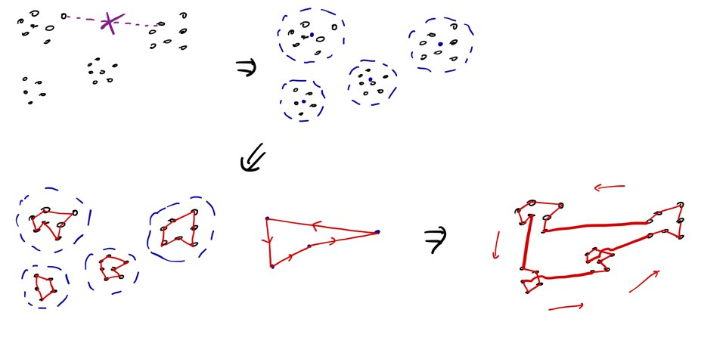
Rough picture

Slide 5
K-means clustering
I’ve decided to exploit the geometric feature of TSP:
If points are clustered together, then they should be nearby in the optimal Hamiltonian cycle, and if points are far away, then they should be far apart.
(Similar to divide&conquer approach)

Slide 6
Intracluster ACO
Each cluster is considered as a TSP instance, and ACO was run.
The ACO hyperparameters as follows:
Since each TSP instance is independent, this process can be parallelized.

Slide 7
Intercluster ACO
Then I considered the TSP instance created by the medians of the clusters.
Again, ACO was run.
Since this instance is very small (if the number of clusters is very small), the ACO hyperparameters were weakly set:

Slide 8
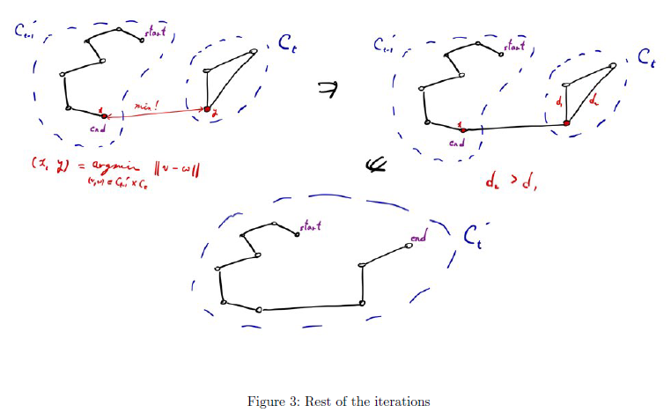
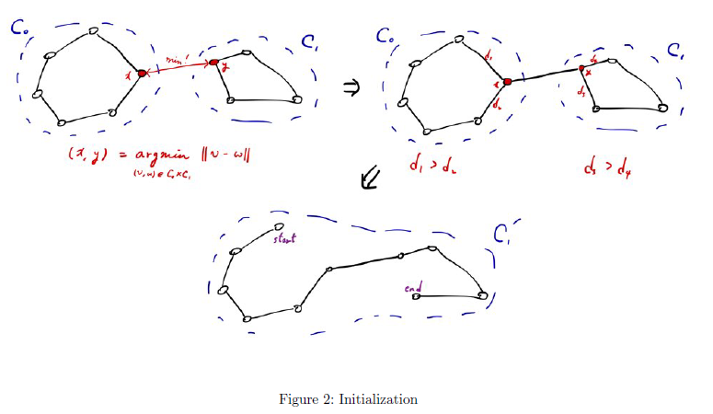
Combine clusters

Slide 9
*3-Opt
3-Opt was used every time a solution popped out of any ACO
At the very last step, 3-Opt is applied one more time.
This enabled for the sub-solutions to be of better quality, and the same for the final solution.
One major problem of this is that the time complexity becomes prohibitively high.
Especially at the very last 3-Opt, in which the time complexity of cubic order of the total number of vertices is added.

Slide 10
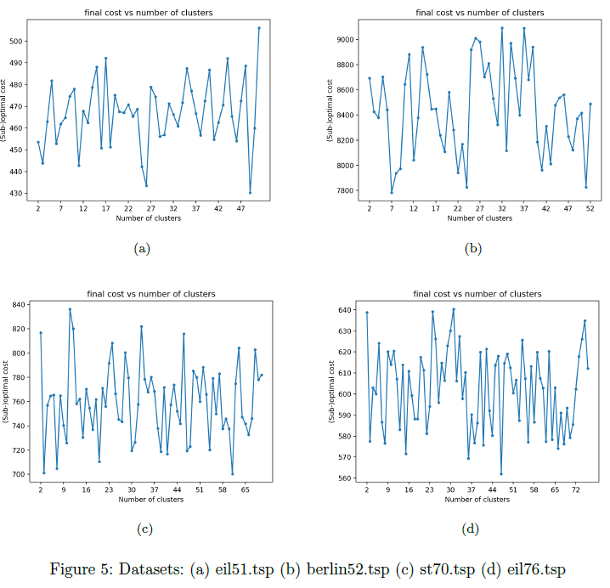
RQ1: Effect of number of clusters

Slide 11
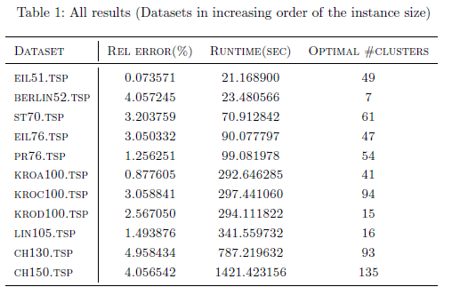
RQ2: Performance of this algorithm

Slide 12
Future work: ACO hyperparameters…
It is known that ACO is sensitive to its hyperparameters, and such optimal set of hyperparameters is problem-specific
Such optimal hyperparameters of ACO can be tuned by using PSO!
Considering how each intracluster TSP requires a different instance of ACO, this is expected to have a very positive effect on the performance.
Especially considering how different clustering leads to different sizes of TSP instances, this is very promising.

Slide 13
Future work: exploiting the metric space
Our TSP is very special in the sense that the edge weights are given as Euclidean metric, which satisfies triangle inequality.
Note that our approach does not make use of such special property.
One example of this is Christofides algorithm, a 3/2-approximation algorithm that is applicable to metric TSP, only.
Somehow incorporating this information into our algorithm is certainly a promising avenue.

Slide 14
Github repository (if anyone is interested…)
https://github.com/nick-jhlee/CS454-TSP-Solver
(Refer to the report document in the git repo for additional details that I’ve excluded for the time being)

Slide 15
Thank you!
Any questions?

